Slide 1

The State of
Federal RPA
An Update on the Governmentwide Impact,
Deployment, and Best Practices of RPA
Nearly three years after the federal government deployed its first robotic process automation (RPA) application, RPA has become a widespread process automation tool. Several RPA programs implement the technology at scale and achieve significant results. They strengthen and empower the federal workforce. This report assesses RPA programs’ maturity across the federal government and RPA’s impact, identifies trends, and highlights best practices for future deployment.
Version 2.0 — Published by the Federal RPA Community of Practice (CoP)
December 29, 2021
Notes:
Table of Contents

Slide 2
Summary of Key Takeaways
KEY TAKEAWAY 1
RPA programs across the federal government are growing. In FY21, federal RPA programs significantly grew and matured.
KEY TAKEAWAY 2
More automations give federal employees more time. The federal RPA community has reduced over 1.4M hours (and counting) of low-value work across the government to date. RPA helps federal employees do more important work.
KEY TAKEAWAY 3
Federal agencies want RPA programs. 65% of RPA programs have over 20 automations in their pipelines; 75% of emerging RPA programs plan to launch a pilot within the next 12 months.
KEY TAKEAWAY 4
RPA programs are using Intelligent Automation (IA) solutions. 32% of RPA programs have incorporated IA features: like machine learning, artificial intelligence, image recognition, chat bots, and natural language processing.
KEY TAKEAWAY 5
RPA programs enhanced their accountability and oversight. 68% of federal RPA programs are currently centralized with program management. Several are becoming ready for audits and developing dashboards for reporting.
KEY TAKEAWAY 6
RPA programs built productive relationships with IT departments. Programs continue to work with IT departments to get approvals and ensure proper security controls.
KEY TAKEAWAY 7
RPA programs adopted more sophisticated technology platforms. 60% of the programs use enterprise platforms. Most are using the cloud.
KEY TAKEAWAY 8
RPA programs developed varied team structures. Program teams balance federal and contract employees.
digital.gov/communities/rpa

Slide 3
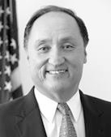

Letter from the Executive
Sponsor
Federal Community:
RPA technology continues to improve processes. This year, RPA programs across the government increased their number of automations in production to around 1K. They created over 1M hours of capacity. Imagine what your agency could do with 1M hours.
For federal employees, this growth allows them to focus on agency mission delivery and improve citizen service. Federal agencies use RPA to speed up and connect financial systems, process HR requests faster, and perform thousands of acquisition functions with a click. RPA allows federal workers to focus on making decisions and doing more for our federal employees and citizens.
Gerard Badorrek
GSA CFO
Federal RPA CoP Sponsor
What’s next? As RPA programs mature, they’ll include more intelligent automation features to maximize efficiency. As programs learn how to apply RPA to cumbersome processes, they’ll use technology to improve public-facing government processes and strengthen customer experience for citizens.
I appreciate all federal partners who contributed to this report. Together, we are making significant progress using RPA as a key tool to strengthen and empower the federal workforce to deliver excellent, equitable, and secure federal services and customer experience.
— Gerard Badorrek
ABOUT THE FEDERAL RPA COMMUNITY OF PRACTICE
With 1,200+ members from over 100 federal agencies, the Federal RPA CoP helps agencies convert RPA enthusiasm into action. The CoP includes a diverse range of members from agency executives to developers, to business line owners and those exploring RPA’s potential.
The RPA CoP’s mission is to help the federal government adopt RPA faster. To do this, the RPA CoP hosts webinars, office hours, and networking events; issues newsletters and publications; and serves as a hub to connect federal employees with others in their own agency and across the government. We help programs explore potential, start pilots, and mature programs and scale quickly to deliver on value and maximize RPA technology’s potential across the federal government.
To join and learn more, visit digital.gov/communities/rpa.
digital.gov/communities/rpa

Slide 4
State of Federal RPA
TABLE OF CONTENTS
Letter from the Executive Sponsor 3
Survey Introduction 5
Maturity Model Scoring 6
Key Takeaways 1 - 8 7 - 17
RPA Program Spotlight 18
Naval Supply Systems Command, Business Systems Center 19
Department of State, Bureau of the Comptroller and Global
Financial Services 20
Department of the Air Force, Office of the Secretary of the Air Force/Financial Management/AFFSO 21
Social Security Administration, Systems (DCS), Office of
Systems Architecture (OSA), Robotic Operations Center (ROC) 22
Army Financial Management and Control (FM&C) 23
Office of the Under Secretary of Defense Comptroller OUSD(C)
RPA Center of Excellence 24
Department of Homeland Security, U.S. Citizen and
Immigration Services 25
United States Department of Agriculture 26 - 27
General Services Administration, Office of the Chief Financial
Officer 28
Survey Methodology 29
Contributors 30
digital.gov/communities/rpa

Slide 5
Survey Introduction
A BRIEF INTRODUCTION TO RPA
Robotic Process Automation (RPA) is a low- to no-code Commercial Off the Shelf (COTS) technology that can automate repetitive, rules-based tasks. RPA products vary in what they do, but all RPA technologies copy human actions. RPA enables trained process owners and employees to rapidly design, test, and deploy automations. RPA dramatically reduces an organization’s low-value workload. Popular uses of RPA include data entry, data reconciliation, spreadsheet manipulation, systems integration, automated data reporting, analytics, scheduled communications, and prepopulated responses to customer inquiries.
For more information on RPA in the federal government, including best practices, lessons learned, and proven strategies for RPA program development and maturity, please go to the RPA Playbook at digital.gov/pdf/rpa-playbook.pdf.
WHY WE SURVEY MATURITY
We publish this report to provide information about RPA’s adoption and impact across the federal government. It describes federal RPA programs’ maturity and progress in automation. We also note successes and challenges that all federal RPA programs face.
digital.gov/communities/rpa

Slide 6
Maturity Model Scoring
FY21 FEDERAL RPA MATURITY MODEL
This Maturity Matrix is designed to help guide federal RPA programs through future growth and challenges. It provides a way to measure program advancement and success over time.
It measures different levels of maturity in each maturity component. In addition to the seven key capabilities we measured last year, we added three emergent capabilities this year in FY21. Point values are assessed by maturity component and align with component objectives for program growth. We’ll assess the three newly developed FY21 maturity components as part of future program objectives.
Maturity Component
Point Value ( )
Automations in Production
1-5 Automations
(5)
5-20 Automations
(10)
20-50 Automations
(15)
50-100 Automations (20)
100+ Automations (30)
Annualized Hours of Capacity Created
0-5k Program Cumulative (0)
5k-50k Program Cumulative (5)
50k-150k Program Cumulative (10)
150k-300k Program Cumulative (15)
300k+ Program Cumulative (20)
Opportunity Identification
Ad Hoc Approach (1)
5+ Application Pipeline (2)
10+ Application Pipeline (3)
20+ Application Pipeline and Active Opportunity Generation (4)
30+ Application Pipeline & Multi-Customer Demand (5)
Process Improvement
No Capability (0)
Basic PI Capability (3)
Intermediate PI Capability (4)
Advanced PI Capability (5)
Program Impact
Processes Automated for Work Teams (1)
Processes Automated for Office-Level Units (2)
Processes Automated for Bureau/Divisions (3)
Agencywide Processes Automated (4)
Governmentwide Processes Automated (5)
Production Environment
Pilot Desktop Automations (1)
VDI Attended Automations (3)
On-Prem Enterprise Platform (4)
Enterprise Cloud Platform (5)
Security and Technology
Pilot Security Approvals and Publicly Available Data (0)
RPA Software ATO / Approval, Using PII on Ad hoc Basis, and Human User Credentials (3)
RPA Software & Enterprise Platform ATO / Approval, Standard Approach to Using PII, and 25%+ Unattended Automations (5)
RPA Software & Enterprise Platform ATO / Approval, Standard Approach to Using PII, and 50%+ Unattended Automations (7)
RPA Software & Enterprise Platform ATO / Approval, Standard Approach to Using PII, and 75%+ Unattended Automations (10)
Intelligent Automation Features
No (0)
Yes (5)
NEW IN FY21
RPA MATURITY SCALE
(TOTAL POINTS EARNED - 100 POSSIBLE)
Community
No (0)
Yes (5)
LEVEL 5: 90-100 points
Audit Readiness
No (0)
Yes (5)
LEVEL 4: 70-89 points
LEVEL 3: 50-69 points
Dashboard
No (0)
Yes (5)
LEVEL 2: 30-49 points
LEVEL 1: 0-29 points
digital.gov/communities/rpa

Slide 7
Key Takeaway 1: RPA programs across the
federal government are growing.
In FY21, federal RPA programs responded to the maturity survey with information about their program outputs and maturity. We saw significant figures in average workload capacity saved, overall pipeline automation numbers, and types of IA technology used. These all show program growth trends across the federal government. The chart below notes the number of RPA programs that fell within each range of maturity component.
MATURITY COMPONENT
NUMBER OF PROGRAMS IN EACH RANGE
Automations in Production
0-5 Automations
6-20 Automations
21-50 Automations
51-100 Automations
100+ Automations
20
16
7
5
1
Annualized Hours of Capacity Created
<5K Annual Hrs
5K-50K Annual Hrs
50K-150K Annual Hrs
150K-300K Annual Hrs
300K+ Annual Hrs
26
12
10
0
1
Process Improvement Capabilities
Office Level Units
Basic Capability
Intermediate Capability
Advanced Capability
21
11
12
5
<5 in Pipeline
5+ in Pipeline
10+ in Pipeline
20+ in Pipeline
30+ in Pipeline
Program Impact
22
7
6
12
2
*Opportunity Identification
<5 in Pipeline
5+ in Pipeline
10+ in Pipeline
20+ in Pipeline
30+ in Pipeline
5
5
3
13
11
Production Environment
Pilot Desktop Automations
VDI Attended Automations
On-Prem Ent Platform
Ent Cloud Platform
15
4
14
16
Security and Technology Approach
<5 in Pipeline
5+ in Pipeline
10+ in Pipeline
20+ in Pipeline
30+ in Pipeline
21
16
4
2
6
No
Yes
*AI / IA Capabilities
31
14
No
Yes
*Community
24
22
No
Yes
*Audit Readiness
15
30
NEW IN FY21
No
Yes
No
*Dashboard
28
16
* In some instances, not all 49 RPA programs responded to the survey questions. Answering survey questions was voluntary.
X
X

Slide 8
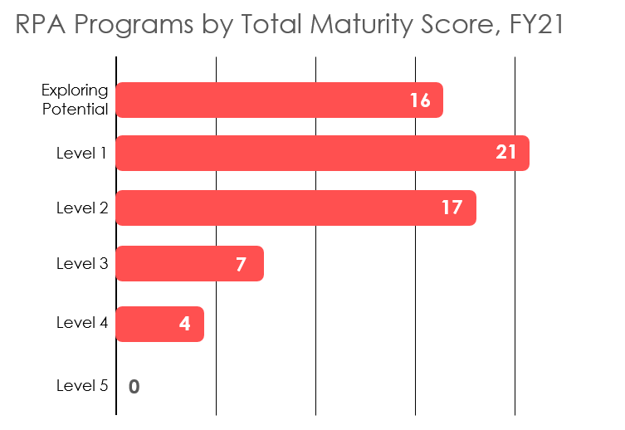
Key Takeaway 1: RPA programs across the
federal government are growing.
TOTAL PROGRAMS / OFFICES ASSESSED | 65
RPA MATURITY SCALE
(TOTAL POINTS EARNED - 100 POSSIBLE)
LEVEL 5: 90-100 points
LEVEL 4: 70-89 points
LEVEL 3: 50-69 points
LEVEL 2: 30-49 points
LEVEL 1: 0-29 points
digital.gov/communities/rpa

Slide 9
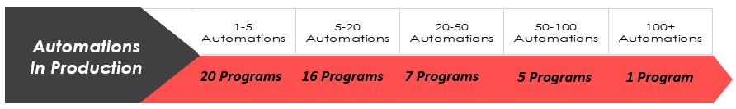
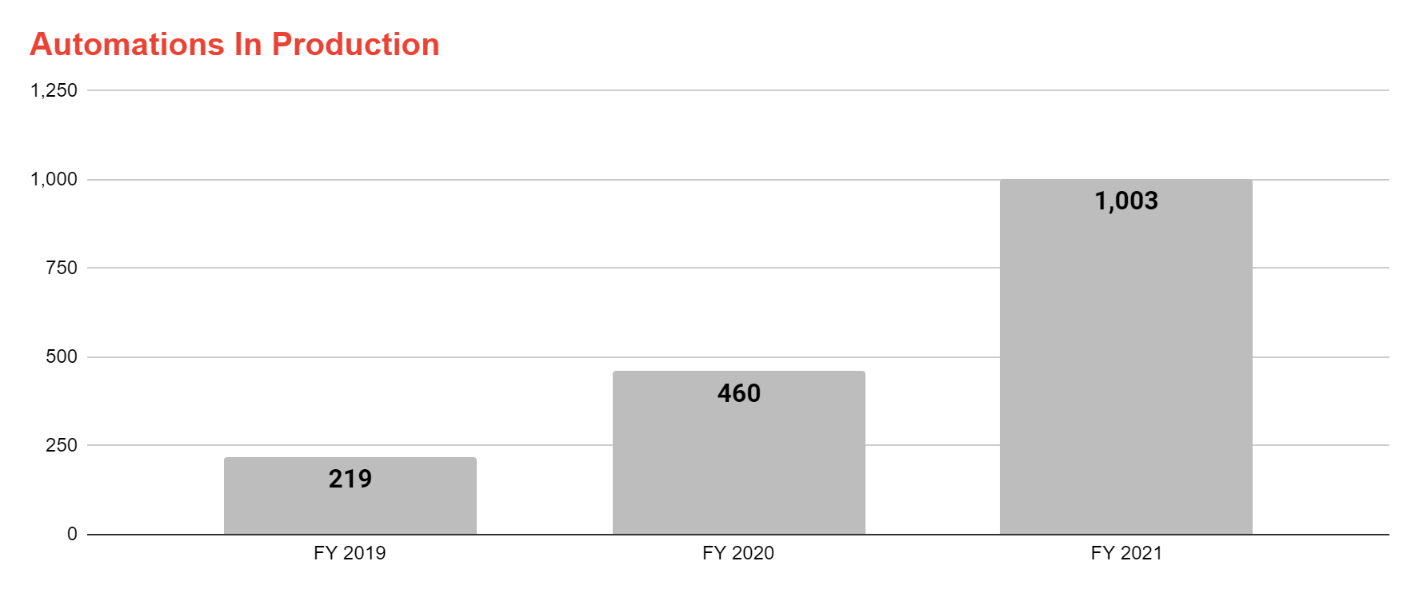
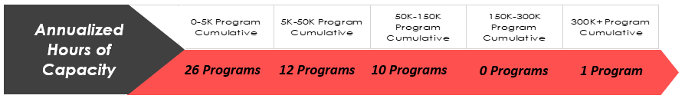
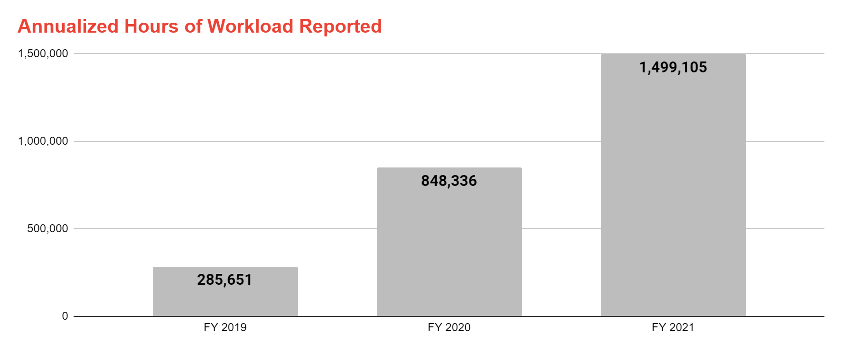
Key Takeaway 2: More automations equal more
capacity for federal employees.
Survey results show that federal RPA programs are deploying 2.5 x the amount of automations from last year, which has driven increased capacity for federal mission areas. Federal RPA programs now have 1,001 automations in production, with just as many in the pipeline. These current and potential automations offer 1,499,105 cumulative hours of capacity created.
Maximized Potential
Increased automations across government has reduced federal employees’ manual work (like data entry and transferring data between systems). This increased capacity helps to maximize the federal workforce’s focus on agency missions.
Realized Investment
The best way to assess RPA program value is the number of automation hours saved by programs. This number shows RPA’s effectiveness at solving an agency’s workload and helps define the purpose and return on investment (ROI) in federal RPA programs.
digital.gov/communities/rpa

Slide 10
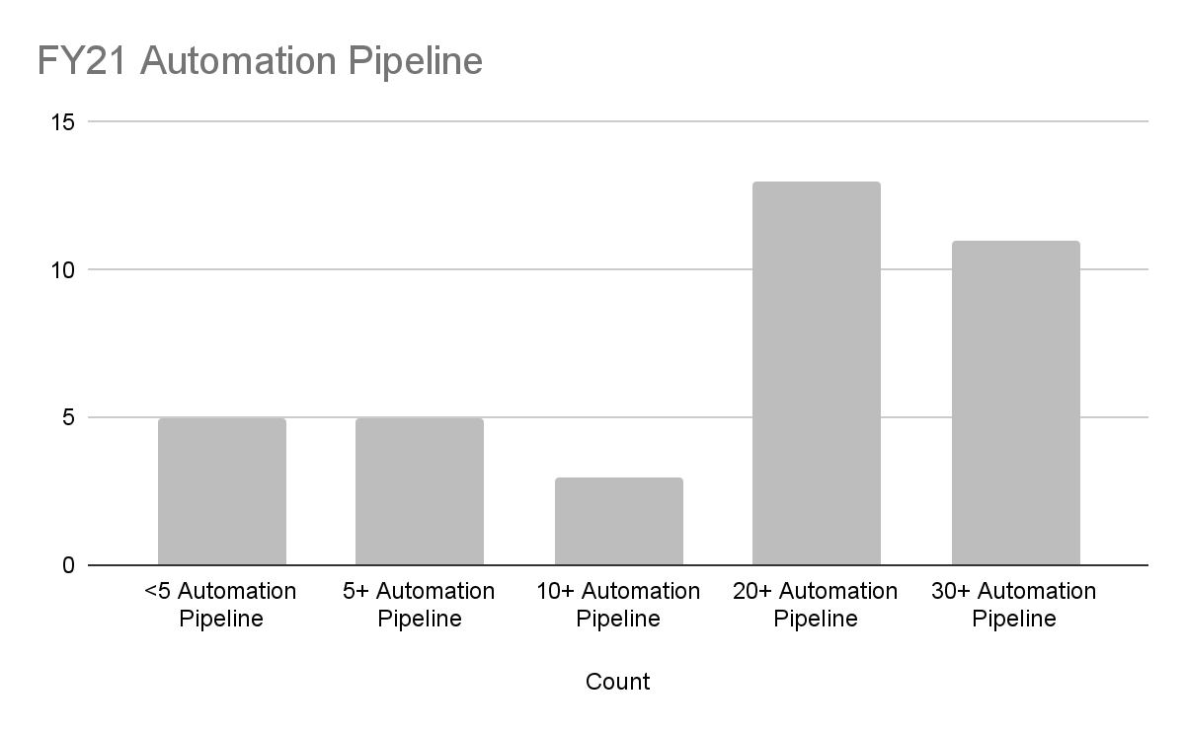
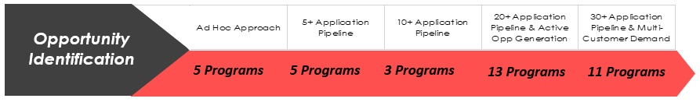
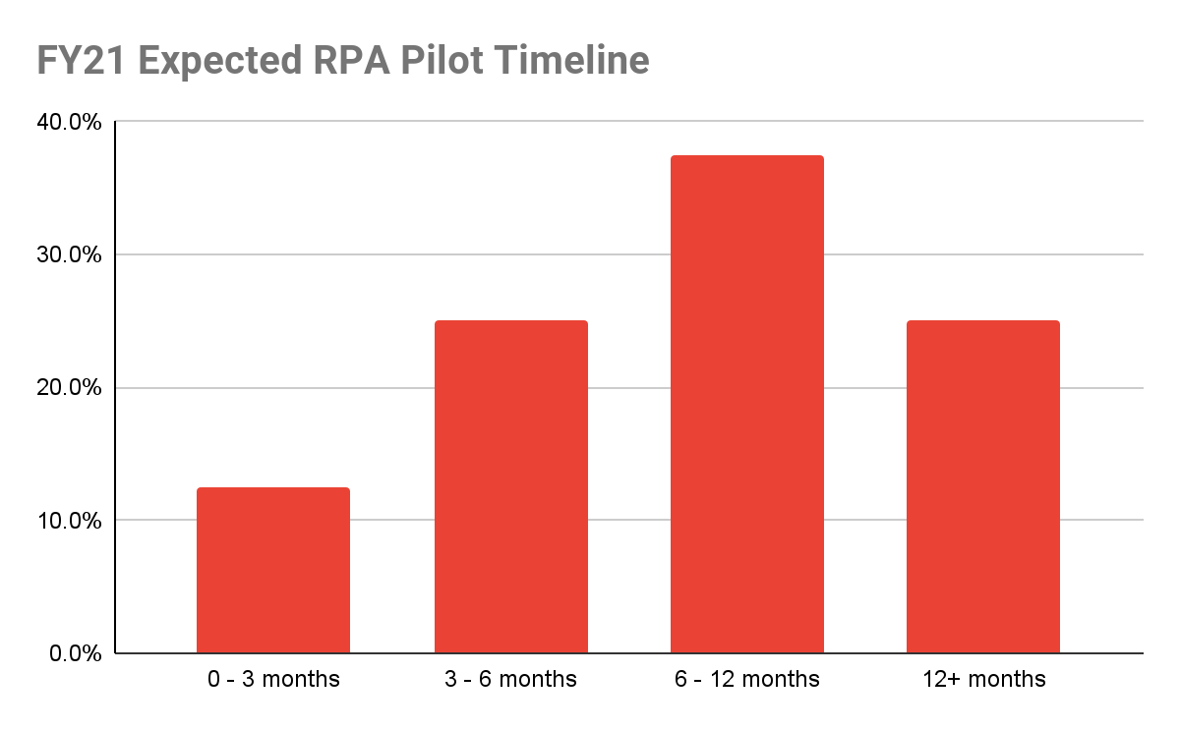
Key Takeaway 3: Federal agencies want RPA programs.
Strong RPA Demand
Strong RPA program pipelines across the government indicate customer demand for RPA. Federal agencies should invest in RPA, as RPA deployed at scale increases ROI. Further, 25% (16) of the survey respondents are exploring RPA’s potential, indicating interest in developing new programs.
Automation Pipeline
A valuable metric for assessing RPA demand is the number of automations in each RPA program’s pipeline. This number indicates both how RPA applies as a solution to an agency’s operating challenges and also key stakeholder interest in pursuing RPA. Stakeholders and business process owners want to adopt RPA solutions for their business needs.
Emerging RPA Programs
25% (16) of program offices responded they are exploring RPA potential. 75% (12) of those expect to have a pilot in place within the next 12 months.
digital.gov/communities/rpa
Notes:
Federal program managers are increasingly turning to RPA to disrupt stale business processes and add capacity to their organization. This wasn’t always the case. In FY 2019, federal RPA programs identified process discovery as a significant obstacle to RPA adoption indicating a lack of demand from process owners. RPA programs faced the daunting task of identifying new processes for automation which involved roadshows and awareness campaigns targeting a broad array of stakeholders. In FY 2020, RPA programs have reported progress and an increased ability to uncover new processes for automation. Once hesitant process and system owners are embracing RPA technology, filling pipelines with processes ripe for automation.

Slide 11
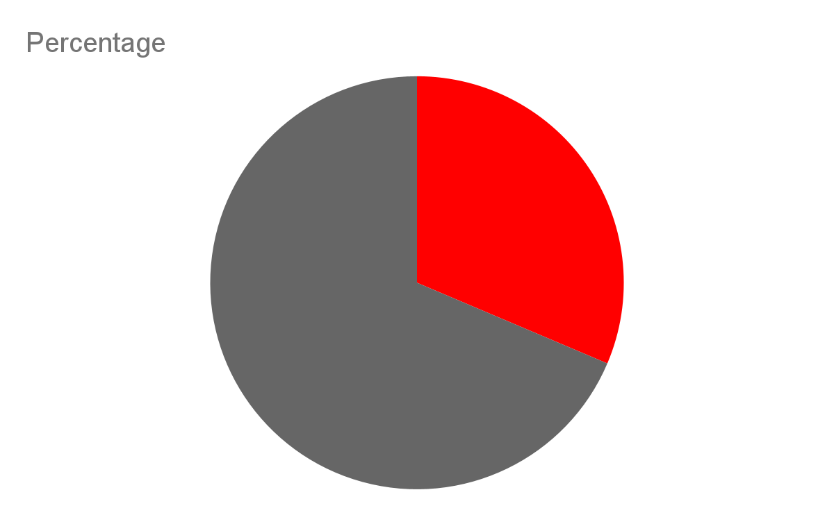
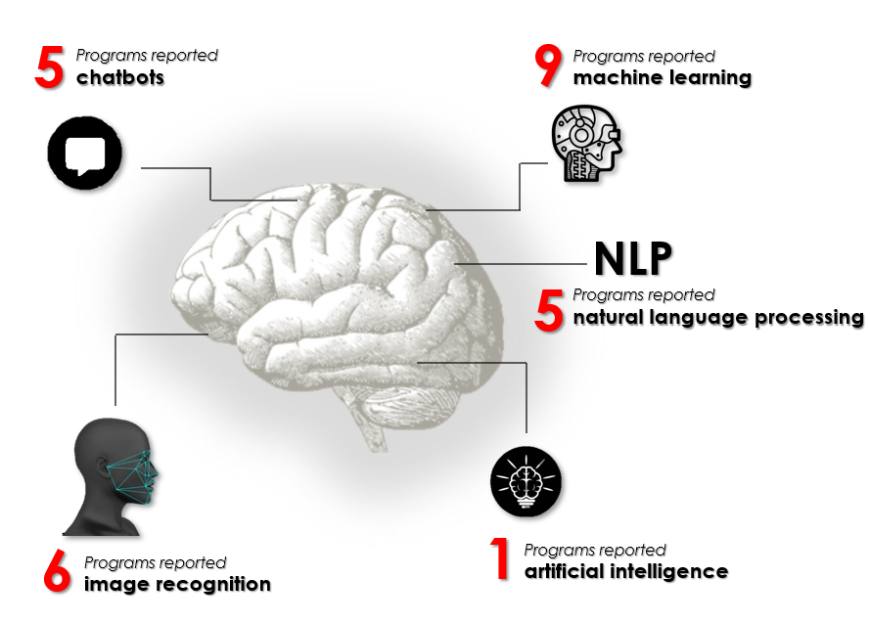
Key Takeaway 4: RPA programs are using Intelligent Automation (IA) solutions.
Intelligent Automation
Federal RPA programs are moving toward adopting more advanced program technologies. 32% (14) of RPA programs have incorporated IA technologies into their RPA programs.
Programs that want to mature their capabilities will adopt advanced sensory tools and IA. They will allow them to use more robust and capable automation solutions for end-to-end processes.
32%
Yes
68%
No
digital.gov/communities/rpa

Slide 12

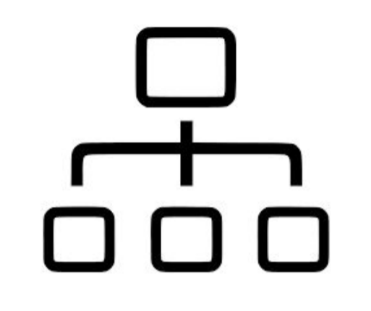
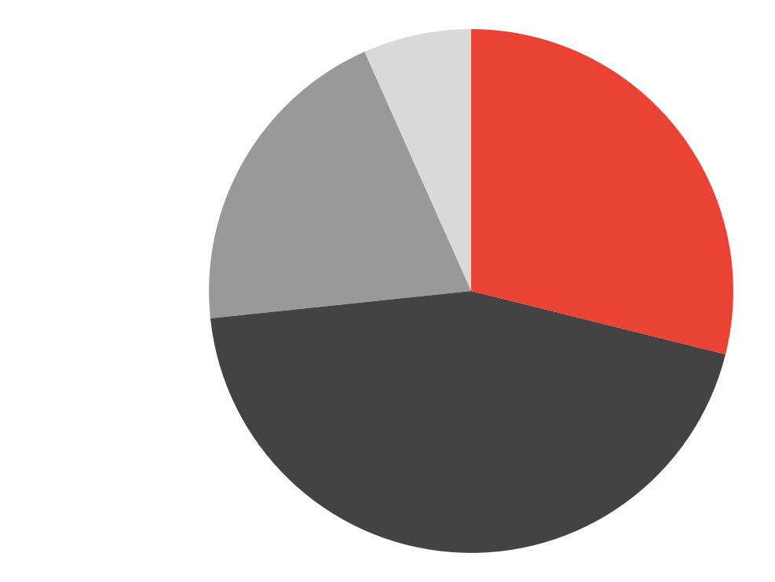

Key Takeaway 5: RPA Programs enhanced their accountability and oversight.
The maturity survey included five new maturity components to provide insight into accountability and oversight of RPA programs.
Most RPA programs use mature governance models,
Most RPA programs have taken steps to make their programs audit ready,
Most RPA programs have an internal agency RPA community of practice to train business lines and increase adoption across the agency,
Programs use management dashboards to track program analytics and performance indicators, and
Most RPA programs evaluate and track their program’s benefits.
Governance Model
Other
14%
Governance models show how an RPA program will operate and can structure its oversight. 68% of RPA programs (33) use a centralized or federated governance model
27%
Federated
to manage their operations.
Mature programs use either a centralized or federated governance model because they provide structure and hierarchy for RPA programs.
18%
Decentralized
41%
Centralized
Audit Readiness
61% of RPA programs (30) have taken steps to make their programs audit ready. Audit readiness reflects internal controls, practices, and systems that create confidence that information can withstand an audit. Programs that are audit-ready are taking steps towards accountability.
digital.gov/communities/rpa

Slide 13


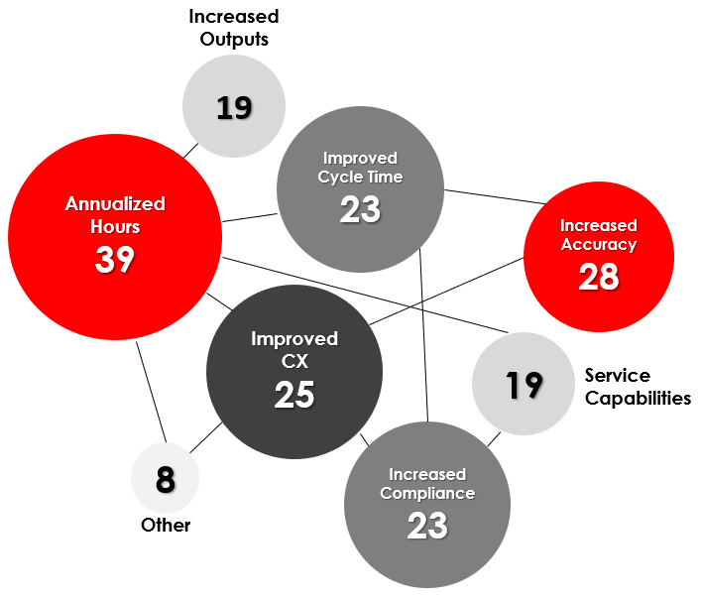

Key Takeaway 5: RPA Programs enhanced their accountability and oversight (cont’d).
Internal RPA Community of Practice
45% (22) of RPA programs host an internal RPA community of practice. Internal COPs connect RPA developers, business line owners, and others to educate and increase RPA adoption within an agency. COPs can help programs share and solve common challenges with RPA, share interest in RPA, and fulfill both individual and group goals. An internal RPA CoP shows program maturity. It shows that programs have increased interest, offered opportunities, and used collaboration within their organizations to sustain their programs.
Management Dashboard
33% (16) of RPA programs have developed an RPA program management dashboard. Management dashboards show a snapshot of key performance indicators. Decision makers can use the dashboard to judge if operations are on track and measure how performance goals are doing. Developing management dashboards shows a maturing RPA program. Dashboards provide the most important information that teams, managers, and stakeholders need to know in order to make program decisions.
Evaluation and Tracking
90% (44) of RPA programs use at least one measure to evaluate and track RPA benefits. The most common measurement of RPA benefits was annualized
hours saved and/or hours of capacity created.
Using different metrics to evaluate and track RPA benefits shows a maturing RPA program as it quantifies its benefits and successes.
digital.gov/communities/rpa

Slide 14
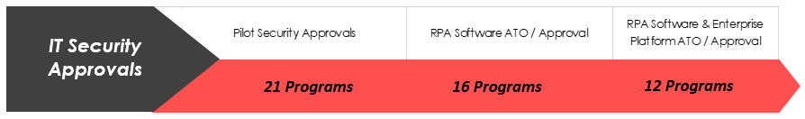


Key Takeaway 6: RPA programs built productive relationships with IT departments.
The maturity survey asked RPA programs how they approached security and technology. Questions focused on IT security approvals, automation credentialing, and data privacy controls. Measuring these components can help illustrate the state of RPA when navigating IT approvals.
Many federal RPA programs report using low level security and technology measures. Federal programs should expect this, as new RPA programs are introduced and their framework and standardization are developed. Developing common security and technology approaches can strengthen RPA in the federal government.
IT Security Approvals
RPA programs need a formal authority to operate (ATO) for select applications and enterprise platforms/services within an agency’s IT environment. Individual automations within an RPA program may also require various approvals from systems owners, process owners, and other stakeholders.
Successes
Challenges
33% (16) of RPA programs use software ATO / Approval
24% (12) of RPA programs use software & enterprise platform ATO / Approval
43% (21) of RPA programs use pilot security approvals. These increase risk within IT security approvals
digital.gov/communities/rpa

Slide 15
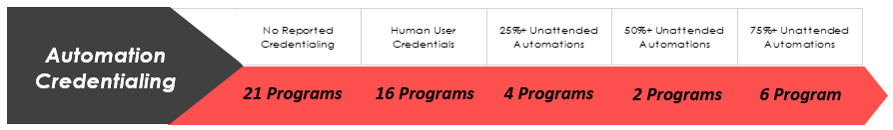

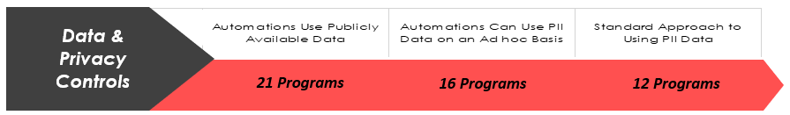
Key Takeaway 6: RPA programs built productive relationships with IT departments (cont’d).
Automation Credentialing
Successes
24% (12) of RPA programs use either a mix of human user and NPE credentials or non-person entity credentials.
RPA programs must develop and promote credentialing processes to manage RPA identity and access to IT systems and data. Federal guidance requires these processes. These processes establish a formal policy for authenticating users, monitoring access rights, and ensuring policy compliance.
Challenges
76% (37) of RPA programs use either automation credentialing strategy that uses human user credentials or no credentials. These methods are less secure credentialing processes.
21
Successes
16
24% (12) of RPA programs use a standard approach to protecting PII data.
Data and Privacy Controls
Agencies often implement data privacy controls at the individual automation level. All agencies have privacy policies in place that govern how data is stored, accessed, and used. Privacy thresholds are generally applied based on how sensitive the data is that the individual RPA application stores and uses.
6
Challenges
76% (37) of RPA programs use publicly available data or PII data on an ad hoc basis for data privacy controls. This increases risk with data security.
digital.gov/communities/rpa

Slide 16




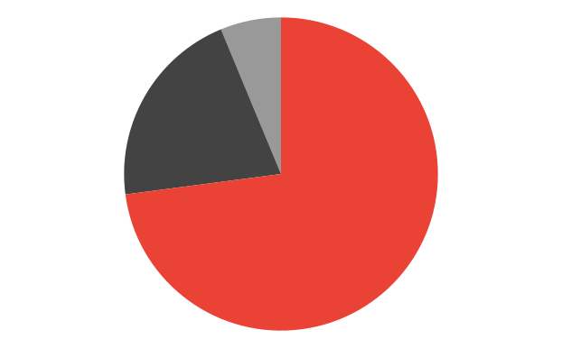
Key Takeaway 7: RPA programs adopted more sophisticated technology platforms.
RPA programs gave specific platform information about their technical RPA program architecture. Overall, programs are adopting more sophisticated technology platforms.
+60% (30) of RPA programs report using enterprise platforms, with the majority using the cloud, which shows maturing programs.
RPA Program Production Environment
Pilot Desktop Automations
VDI Attended Automations
On-Prem Enterprise Platform
Enterprise Cloud Platform
FY21: 23% (11) of RPA programs use desktop automation as their production environment.
FY21: 8% (4) of RPA programs use VDI as their production environment.
FY21: 29% (14) of RPA programs use a functioning enterprise on -premises (on-prem) production environment.
FY21: 33% (16) of RPA programs use a functioning enterprise cloud production environment.
Over half of the programs surveyed use either on-premise enterprise platform or enterprise cloud platform.
RPA programs are maturing. Programs are evolving, going from using pilot desktop automations and VDI attended automations to on-premises enterprise platforms. Most are advancing to using cloud.
Separate Environments for Development and Production
2% No Response
77% (36) of RPA programs have separate production environments for development and testing. This shows maturing programs as separate environments protect production data and makes sensitive information more secure.
21%No
77%
Yes
digital.gov/communities/rpa

Slide 17
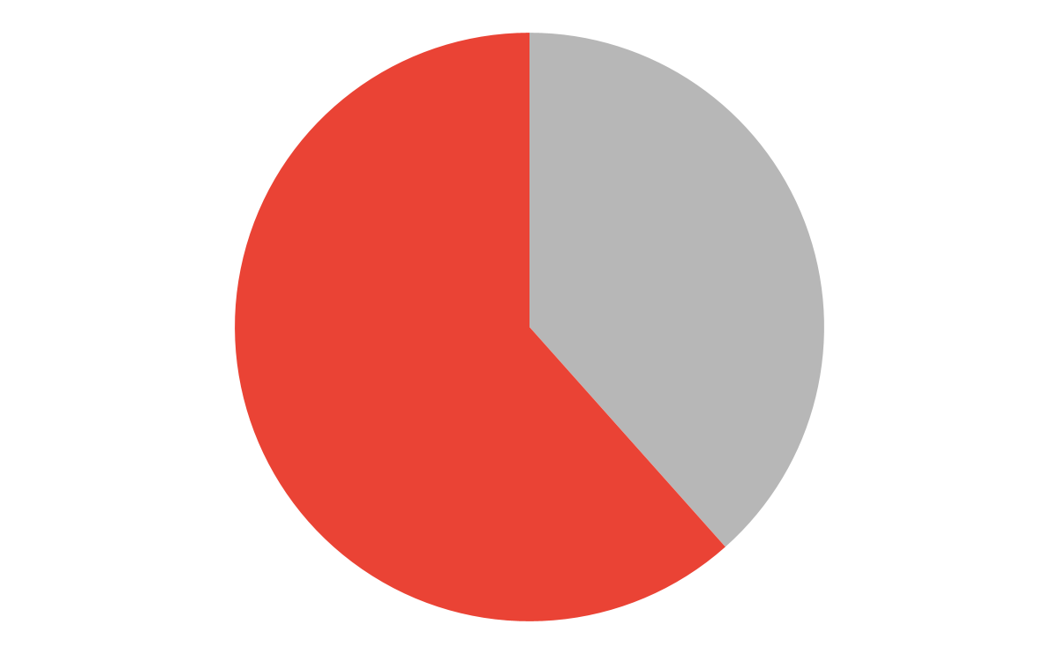
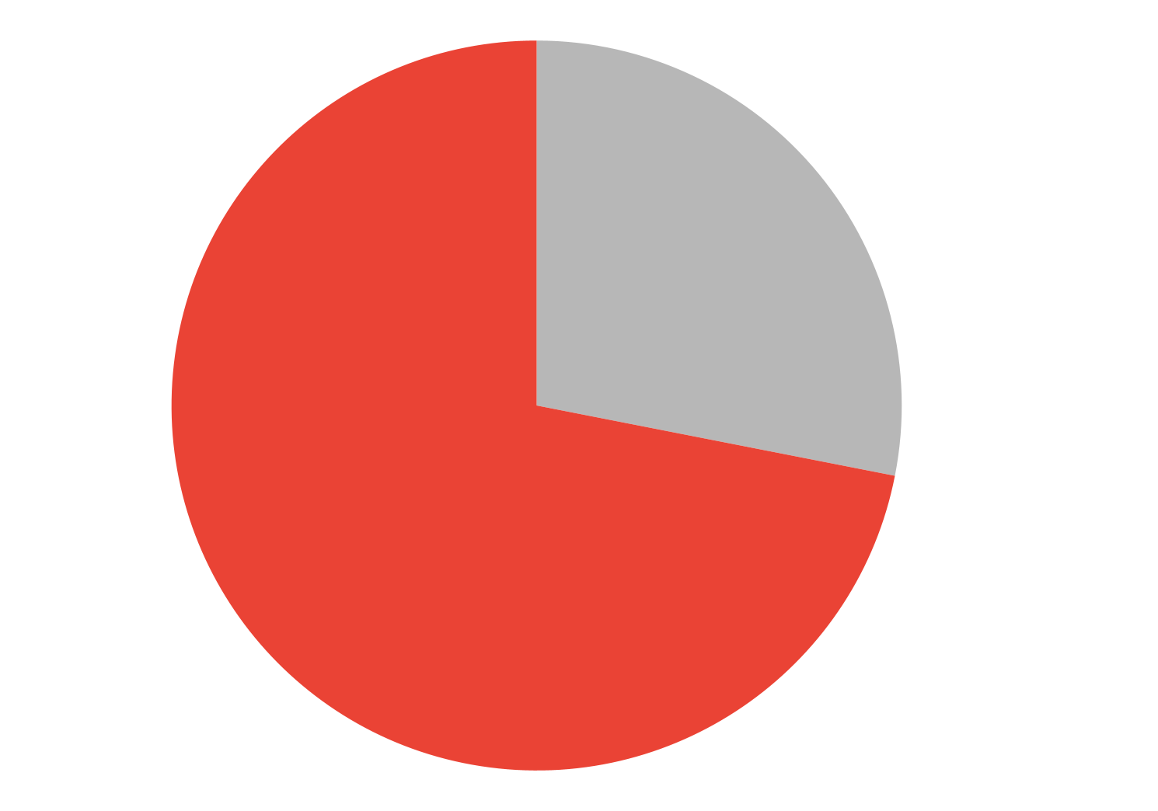
Key Takeaway 8: RPA programs developed varied team structures.
Federal RPA programs continue to build/balance robust teams. RPA programs must consider staffing and long-term workforce planning to match increasing RPA demand; programs must make key decisions about using federal full time employees (FTE) or contractors to develop and manage the RPA program.
Federal RPA programs teams include analysts and developers. A developer designs and programs automations. A business analyst identifies problems, gathers requirements, and documents process steps. RPA programs use the following team setups.
Program/Business Analysts on RPA Teams
RPA programs have a total of 216 full time program/business analysts working on their teams. 38% (83) are federal employees and 62% (133) are contractors.
62% Contractor
38% Federal
Developers on RPA Teams
RPA programs have a total of about 235 full time developers working on their teams: 28% (66) are federal employees and 72% (170) are contractors.
28% Federal
72% Contractor
digital.gov/communities/rpa

Slide 18
Federal RPA Program Spotlights
A showcase of automation use, exploration,
strategies, and growth.
Notes:
Table of Contents

Slide 19
Program Spotlight: Naval Supply Systems Command, Business Systems Center
Top Five Program Successes
Naval Supply Systems Command (NAVSUP) Business Systems Center (BSC) uses RPA to increase value-to-mission and scale efficiencies across the enterprise. Major accomplishments include:
Made comprehensive RPA processes operational from conception to automation execution.
Produced a robust, federated governance model that provides program structure and enables commands to establish their own Robotic Operations Centers (ROCs).
A centralized RPA portal hub for opportunity input, tracking, dashboards, and program information content.
Supported employee readiness and RPA engagement by training nearly 100 NAVSUP employees with “RPA 101” and onboarding over 20 RPA citizen developers.
Identified a total of 73 opportunities, worked 27 automations (+8 in production), saved +14,000 labor hours and improved quality of life for service members and civilian employees.
RPA Use Case Spotlight
NAVSUP BSC’s HAZMAT Automation increased value-to-mission performance and improved operational quality by automating manual entry of data into Navy ERP. This automation opens and reads data from the web-based platform (Hazardous Material Management Tool) and automates entering material, quantity, where, batch, partner, and Navy custom field tabs in the goods movement transaction code in ERP.
"This automation allows our customers to condense what was once a tedious procedure into a short intuitive process. What took days or weeks to train now takes an hour or so."
- Shane Dreese, Ashore HAZMAT technical lead at NAVSUP Weapon Systems Support
Based on historical workload data, over 120,000 transactions took an average of three minutes to manually input into ERP at more than 70 locations. HAZMAT Automation's potential ROI is about 6,200 hours saved every year.
Program Strategy
Under the NAVSUP BSC leadership who championed the program, the RPA Federated Governance model provided the structure, methodologies, best practices, and support to deliver eight viable automations and increased program maturity.
NAVSUP BSC’s RPA program successes during its first full year of operations relied on the Governance Team’s six strategic principles: * engaging with key stakeholders and leadership; * using a value-focused mindset to quickly identify process automation opportunities; * delivering RPA with speed and agility via the myNAVSUP RPA Portal and BOT Templates; * developing expertise with tailored training and over-the-shoulder support model; * evolving into a self-sustaining program by empowering citizen developers to create their own automations; and * focusing on security and IA compliance.
What’s Next/2022 Goals
We made grand strides in our first year of operations. Our desire to increase program maturity drives our program’s year two focus areas. We want to keep increasing our positive ROI, we also want to distinguish ourselves as an established leader in RPA. We have to focus on daily service operations to ensure stability, satisfaction, and increased efficiency;
We want to help Fleet Logistic Center establish their own ROCs for program scale;
We want to prioritize automation opportunities to deliver high value return on investment automations; and,
We want to develop a growth, advanced-capabilities mindset and forward thinking to accelerate Intelligent Automations within NAVSUP.
Program Lead and POC: Allison Holle, RPA Project Manager
digital.gov/communities/rpa

Slide 20
Program Spotlight: Department of State, Bureau of the Comptroller and Global Financial Services
Top Five Program Successes
Established a successful and operational RPA Center of Excellence (COE).
Established RPA within the organization through communication and practice.
Identified over 100 business scenarios that would benefit from RPA.
Established a full RPA design and development process that uses requirements gathering; Lean Six Sigma reviews; agile development methodology; extensive testing procedures; and maintenance.
Deployment of over 35 production bot processes that have created an estimated 50,000 hours of annual capacity.
RPA Use Case Spotlight
In response to the COVID-19 crisis, the State Department faced a global evacuation of at-risk employees and eligible family members. We used the Subsistence Expense Allowance (SEA) program that gives the funds needed for these people to evacuate and reach safe haven. The legacy process was very time consuming and paper intensive for each evacuee.
In response, the RPA team created an automated process that redesigned and simplified the evacuee intake process. This scraped data from the intake form and produced an official calculation sheet; it then loaded approved calculation sheets into the financial management system. Data was then cross-referenced to get payee information. The bot also used the latest GSA per-diem rates to build calculations. This saved an estimated 2,000 hours of surge capacity each month during the pandemic.
Program Strategy
These factors were key to the program’s success:
We put the technology in the hands of the subject matter experts. Instead of bringing in new staff who didn’t know business processes, we trained staff who already understood the processes well and were already interested in technology.
Our leadership was fully on board and proactively communicated, deployed, and established the Center of Excellence. This messaging was key for the program’s initial adoption and success.
We worked with the security team to address all concerns. This led to an attended automation solution that used the existing security structure and minimized risk.
We implemented a full design and development process that used Lean Six Sigma reviews up front, and extensive testing before deployment. This review ensures the processes are fully understood and functionally sound before any automation activity.
Advice for New Programs
When getting started, take extra care to find the best scenario for your proof-of-concept automation. You’ll use this scenario over and over again. Ensure it’s easy to show the technology and its benefits. Find a simple process to automate first (e.g., PDF reconciliation, pulling and consolidating files/data) to increase your chance of success.
Engage the Security and IT teams first to address concerns before moving forward with any automation. The RPA team and the process will benefit from their early involvement.
Don’t jump to a solution! Your first instinct may be to use RPA for everything. Don’t. Make sure you fully evaluate every business case with a full process review before automating. In some cases, other technologies or functional changes may be better than RPA, so make sure your RPA team considers available alternatives.
Program Lead and POC: Sarah Mollohan, Chief of Systems Coordination and Implementation within CGFS
digital.gov/communities/rpa

Slide 21
Program Spotlight: Department of the Air Force, Office of the Secretary of the Air Force/Financial Management/AFFSO
Top Five Program Successes
Deployed 27 automations at AFFSO, saved over 197,000 cumulative automation hours.
Delivered automations that directly address audit findings and enhance internal controls for Financial Management (FM).
Refined RPA lifecycle governance and gate reviews to reduce automation development times, streamline documentation, and expedite engagement with process owners to capture and validate requirements.
Established the RPA sustainment team to provide dedicated support for automation change requests and enhancements.
Expanded pipeline to 20 automations with continued focus on processes related to audit support, NFR remediation, labor efficiency, time savings, and modernizing FM operations.
RPA Use Case Spotlight
Defense Travel System (DTS) Management Information System Report (MIS) is an automation that pulls reports from DTS and WebDMO COGNOS. It aggregates and formats them to provide each Air Force base with a consolidated view of pay and allowances associated with official member travel.
The DTS MIS Report is awaiting signature by the Air Force Accounting and Finance Office as the standard bearer through policy, adopting its use throughout the entire AF Financial Management community.
This automation provides precomputed, actionable data that can be used by Airmen at every AF installation, cumulatively resulting in 1550 automation hours per month.
What’s Next/2022 Goals
As the DMAS RPA program wraps up a successful 2021, we look forward to continuing that momentum into 2022 with a focus on expanding through developing partnerships and leveraging technological advances in RPA.
Our team has set its sights on continuing to develop partnerships with Airmen within the FM community, encouraging and supporting citizen development, and aiming to deliver 20 new DMAS automations. Also, we continue to integrate into the greater Air Force RPA Center of Excellence helping to brand and shape the future of RPA. We are also taking the lead on standing up and managing the AF Orchestrator. We remain committed to expanding into new technologies.
In 2022, our goal is to grow into chatbot technologies that connect Airmen to better support—faster service, integrating unattended automations capabilities with unattended environment and non-person entities—and to take a deeper look into artificial intelligence (AI) and its capabilities within RPA.
Program Strategy
The DMAS RPA program strategy focused on applying RPA and Intelligent Automation to support audit remediation and modernization of financial management operations, while also expanding RPA across the Air Force.
DMAS established leading-practice standards for RPA governance and lifecycle management for the Air Force RPA Center of Excellence (CoE), as well as managed the AF CoE Orchestrator for license and tenet structure management. DMAS can continue delivery of high-quality automations and manage a high-performing PMO with sophisticated processes, documentation, and controls.
Also, our strategy will focus on continuous monitoring of cost, schedule, and performance metrics to identify opportunities for scaling and resource optimization, leading to further expansion of value-added application of automations to support citizen developers.
Program Lead and POC: Michael Green, PMO
digital.gov/communities/rpa

Slide 22
Program Spotlight: Social Security Administration (SSA), Systems (DCS), Office of Systems Architecture (OSA), Robotic Operations Center
Top Five Program Successes
The Robotic Operations Center (ROC) works closely with partners across the SSA enterprise to develop automations that provide value. Our major accomplishments include:
Developed close working relationships with our business partners.
Expanded our user base from 300 to 3,000 end users.
Automations saved over 70,000 work hours for FY21.
Built several single-use automations that solved specific challenges that would otherwise have required significant manual interventions by staff.
Established and implemented a citizen developer program that dozens have already taken advantage of.
RPA Use Case Spotlight
While administering retirement and disability benefits, SSA employees need to manually adjust a beneficiary’s Social Security record. Employees use the Manual Adjustment Credit and Award Data Entry (MACADE) system to make the changes, which are processed overnight. During this overnight processing, these updates can fail for various reasons. These failures mean that the employee must correct and re-input the change.
The MACADE Accuracy Bot (MAB) determines if the adjustment will result in an exception. It alerts the employee to the issue and gives feedback on how to correct it.
Currently, this automation runs nearly 4,000 times daily and detects over 18 possible exceptions that can delay processing.
Program Strategy
Our program focuses on providing value across the enterprise. The RPA program resides within the Office of Systems that supports all the business activity across the agency. With over 60,000 employees, we decided to focus our initial efforts on proving the tool’s value, by giving multiple automations to the eight processing centers that support operations to aid them in their daily work. The Chief Business Officer and the Office of Electronic Services and Technology identified the major workloads to target for automation. The business owners prioritized based on the impact and value that translate into hours saved.
Overall, we stay focused on providing our customers value that is quantifiable.
What’s Next/2022 Goals
Many areas will support growth for the RPA Program as we move forward:
Continue to build and provide bots that significantly save work hours.
Make unattended bots available to the enterprise.
Find a use case that combines AI and RPA to deliver an intelligent automation.
Grow the user base in a targeted manner.
Continue to support citizen developers by educating and mentoring employees interested in RPA.
As SSA continues to scale our RPA offering across the organization, we will continue to focus on adding value with everything we do.
Program Lead and POC: Russell Kuehn, RPA Project Manager
digital.gov/communities/rpa

Slide 23
Program Spotlight: Army Financial Management and Control (FM&C)
Top Five Program Successes
Our RPA team expanded the Enterprise Unmatched Transaction (eUMT) automation program to five commands across the Army. This program resolves financial errors in Army accounting systems with minimal manual labor and has processed 100,000 errors since its inception.
The team deployed its first automation on Secret Internet Protocol Router Network (SIPRNet) to support ongoing audit readiness activities.
One of our primary goals is to remove our legacy accounting systems (SOMARDS). The RPA team developed multiple automations to help, including one that adds capabilities to a legacy system over 40 years old.
We recognize the impact of low- and no-code development, including RPA. As part of our modernization strategy, we have incorporated RPA as a discipline of interest in our digital transformation strategy.
Data analytics are important for supporting all of our operations. We developed several automations to enable data pipelines from legacy source systems into platforms like Vantage and Advana.
Program Strategy
Our RPA program is a mature team that develops and maintains automations ranging from daily reports for single commands to capabilities affecting the entire enterprise. Key to our success is how we integrated it into the financial management functional community. The program sits in the same organization as policy makers and accounting system owners. Clear lines of communication among technical, functional, and policy teams enable the RPA program to identify high value business processes for automation that align to organizational goals and provide institutional help clearing hurdles. A key example is the SOMARDS Divestiture effort, a high priority for us. The RPA team was brought on to plug capability gaps in system migration. To enable automation development, our leaders got the RPA team and system integrators to cooperate, speeding up otherwise time-consuming processes. Aligning prioritization and leadership buy-in is a key to program success.
Advice for New Programs
When measuring RPA value in programs, avoid hyper-focusing on hours saved. It’s an important metric, but it’s difficult to harvest those savings from labor. Our team uses hours saved as a guide to automation scale and prioritization. However, harvesting hard cost savings from hours saved through automation is difficult when those activities are spread across hundreds of employees. Instead of hours saved, we approach RPA as a flexible tool that can fill capability gaps when other approaches are cost-prohibitive. RPA is another course of action evaluated against manual processes and traditional change requests. In particular, it’s useful for adding capabilities to legacy systems when system changes are difficult.
Automating existing manual processes in legacy systems is a good way for RPA to help organizations achieve real cost avoidance.
RPA Use Case Spotlight
Our most impactful automation is the eUMT program. It is a suite of automations that resolves financial errors in our accounting system. The automations follow financial best practices by pulling research and documentation from feeder systems like IPAC and WAWF, then attaching and adjusting records within the accounting system. We’ve already felt its impact – we’ve deployed it to four commands and processed over 100k financial records, saving an estimated 95k hours of manual effort. We’ll rollout the automation to the rest of the active component in FY22.
Program Lead and POC: Chase Levinson, RPA Program Lead
digital.gov/communities/rpa

Slide 24
Program Spotlight: Office of the Under Secretary of Defense Comptroller (OUSD(C)) RPA Center of Excellence
Top Five Program Successes
The Office of the Under Secretary of Defense Comptroller (OUSD(C)) deployed a DoD enterprisewide shared service RPA platform that provides multiple RPA service offerings. As of November 2021, this platform supports 27 different tenant organizations across DoD, with 240 automations running connected to the platform.
Deployed RPA Analytic dashboards to improve managing and overseeing automations.
Established virtual environments that enable resilient and sustainable RPA development and runtime for both attended and unattended automations.
Implemented unattended automation infrastructure, obtaining an interim ATO in July 2021, with long term ATO anticipated in December 2021.
Deployed 45 attended automations and 1 unattended automation that support 12 organizations across DoD.
RPA Use Case Spotlight
In the first-ever use case for unattended RPA in Advana, our team developed the Firefly automation to supply Afghanistan evacuation data to DoD leaders.
We required faster access to U.S. Customs and Border Patrol data on Afghanistan evacuees. To answer the call, we developed and deployed a bot in 48 hours to retrieve this data and then store it in an environment that provides close to real-time data reporting on evacuation statistics.
By using unattended RPA, we gather reports around the clock and reduce the need for manual initiation. Unattended automations can be scheduled to run at any time and at any given frequency, providing a constant flow of dynamic data for continued analysis. The Afghanistan Evacuation automation saves an estimated 150 labor hours per month.
What’s Next/2022 Goals
Expand the use of unattended automations within DoD by obtaining a full ATO for unattended automation infrastructure and connecting at least five organizations to the overall solution.
Scale existing and new automations to more users/organizations, increasing the impact and benefits of automations. This includes assessing and converting existing attended automations to unattended.
Continually assessing new/more automation tools for including into our shared service platform offerings.
Increase using intelligent automation (ex: machine learning), with RPA.
Continue to improve Center of Excellence to ensure best practices in automation development. This includes enhancing our automation candidate questionnaire and intake process.
Program Strategy
We are partnering with DoD organizations to equip the department with the tools to better manage costly, complex, labor-intensive tasks. We do this by providing:
A shared service RPA platform that helps promote RPA across the department and
Automation development support / best practice recommendations.
By taking advantage of one or both offerings, DoD organizations can improve their RPA programs’ management, oversight, and scale. Groups that are just getting started have a notable advantage - a fast path to automation success.
This shared service collective also encourages automation sharing across the department to minimize duplication and redundancies in automations.
Program Lead and POC: Erica Thomas, RPA Project Manager
digital.gov/communities/rpa

Slide 25
Program Spotlight: Department of Homeland Security, U.S. Citizen and Immigration Services
Top Five Program Successes
Established enterprise RPA Center of Excellence (COE) - use case intake, governance, tests automations, support to citizen developers.
Deployed a Continuous Integration/Continuous Deployment (CI/CD) Pipeline enabling secure, consistent, timely robot deployments.
Integrated RPA technology with the enterprise app store allowing role-based access and downloads of RPA software and real-time license management.
Created a streamlined robot deployment approval process that embeds an Information Security Officer (ISO), virtual Change Control Board (CCB) to approve production releases.
Deployed RPA across critical lines of business including immigration benefits, IT, procurement, human capital, and financial management.
RPA Use Case Spotlight
We deployed an automation for processing a large backlog of pending cases to satisfy a GAO audit. The bot processed 2 million records across 7 regional databases in 1 hour of total runtime. Doing it by hand would have taken 9 months to complete.
This key automation improved the data quality of the operational data store and source systems while ensuring the USCIS Director met the GAO requirements timeline of September 30, 2021.
The RPA COE also produced a bot to do an HR offboarding task. It worked by integrating with the enterprise ServiceNow platform to deactivate the employees in the agency’s Time and Attendance platform. This bot was able to clear a backlog of more than 2000 tickets and ensure 100% accuracy going forward.
Program Strategy
From the start, U.S. Citizen and Immigration Services (USCIS) envisioned an enterprisewide RPA program. They based their strategy on the following three pillars;
Attainable: All agency lines of business should have access to the technology and resources. We enabled a safe and consistent way for everyone in the organization to access RPA through IT partnering.
Sustainable: We implemented an enterprise infrastructure that includes environments for development, test, training, and production. RPA code must be stored in the enterprise code repository and move through a controlled and standardized CI/CD pipeline.
Valuable: We reliably track and report the deployed RPA benefits. The COE forecasts the value for use case prioritization, reports the achieved value for each individual automation and the aggregated program metrics.
Advice for New Programs
Ensure a core dedicated team is in place to consolidate and harmonize the agency’s automation knowledge and initiatives. The team will govern and promote automation across the organization by working together and aligning to key business objectives.
Treat RPA like an enterprise solution in your toolkit. RPA’s ability to use existing infrastructure makes it a great solution for time-sensitive problems. Dedicate resources to evaluate processes to ensure automation suitability. Don’t force RPA as a solution for problems that it can’t solve.
Dedicate the time and effort upfront to establish an automation CI/CD pipeline to ease security and privacy concerns. Work with your organization’s IT department to put safeguards in place to ensure you are complying with governance. Use valuable templates and processes from USCIS and other agencies to lighten your load.
Program Lead and POC: Meikle Paschal, RPA Program Lead
digital.gov/communities/rpa

Slide 26
Program Spotlight: U.S. Department of Agriculture
Program Success Spotlight
The USDA Center of Excellence (CoE) created three dashboards to show automation stages with return on investment (ROI) in the USDA RPA CoE development process.
Intake Dashboard shows the request for a business process automation. It includes an evaluation, review, and approval of the business process.
Development Dashboard shows automations at the development of the process definition document, code, and UAT stages.
Production Dashboard shows automations in the production, operation, and maintenance stages.
How We Improved Our Dashboard Program
See our three dashboards for yourself on the next page.
We continually improve our RPA program. Now, we’re scaling into AI and ML in FY21. Using dashboards also helped us develop enterprise-level automations.
We continually improve by applying our own advice for new programs below: analyze, organize, and visualize the data for your own dashboard.
Program Strategy
We work with business owners and subject-matter experts (SME) to complete a value assessment, collecting the data that feeds into the dashboards. We collect the following data:
Mission area, agency, and/or staff office name
Development model used (centralized, federated, or federated-other)
Amount of time the team spends completing the process today
The average pay grade of the people doing the job
How often the process is executed
We calculate the ROI by the manual labor hours times the frequency times the cost of the labor.
We continually improved USDA’s RPA program by scaling into artificial intelligence (AI) and machine learning in FY21. We also developed enterprise automations.
Advice for New Programs
When we created our RPA dashboards, we tried to answer three fundamental questions:
What data does the RPA dashboard show? The data represented should be relevant to your audience. Our audience mostly comprises executive leaders who want to see the value we provide. Our dashboard shows cost avoidance, total estimated labor hours saved, and the full-time equivalent.
How do we organize the data? We use a SharePoint list with defined mandatory columns. We collect the data for the dashboard during ideation to easily track information from the business owner and SME.
How do we want the RPA Dashboard to look? We want the dashboard to be easy-to-read and intuitive. We use Tableau. Our audience can select the mission area to see their data or the development model to see the data for each specific model.
Program Lead and POC: Lattrice Goldsby, RPA Program Lead
digital.gov/communities/rpa

Slide 27
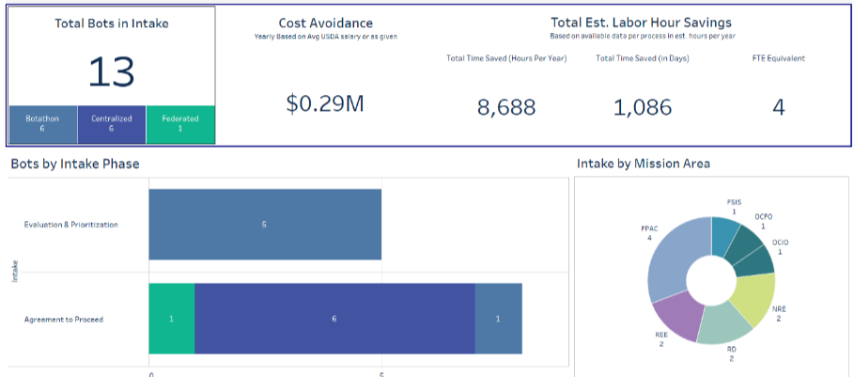
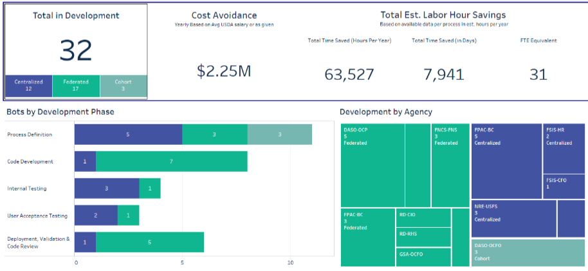
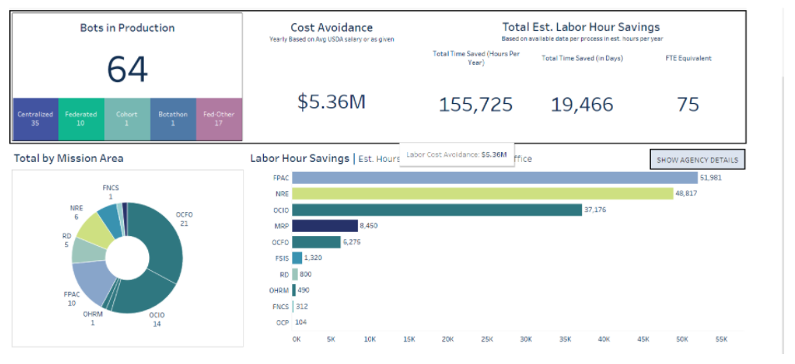
Program Spotlight: U.S. Department of Agriculture (cont’d)
Intake Dashboard
Development Dashboard
Production Dashboard
Program Lead and POC: Lattrice Goldsby, RPA Program Lead
digital.gov/communities/rpa

Slide 28
Program Spotlight: General Services Administration, Office of the Chief Financial Officer
Top 5 Program Successes
Established an Enterprise RPA Program We created a centralized RPA program and have deployed automations in nearly all business lines and mission-support offices including real estate, acquisition, finance, HR, IT, and administrative services.
Automations Deployed - Within three years of program initiation, we deployed 101 cumulative bots using a streamlined RPA Factory approach.
Capacity Created - By the end of FY 21, we delivered over 300,000 annualized hours of capacity, averaging over 3,000 hours per bot.
Strengthening and Training the Federal Workforce - We trained, developed, and redeployed existing CFO employees in RPA development.
Full Suite of Process Improvement Capabilities - We integrated process redesign and improvement capabilities including process mapping, reengineering, future state planning, and performance measurement into RPA projects.
Use Case Spotlight
Federal buyers do not buy like individual shoppers. They buy at significant scale, often with thousands of items per purchase.
Our Market Research as a Service Bot aggregates multiple part numbers within a potential client’s shopping cart to produce a consolidated market research report with price, delivery, contractor information, contract details, and a comparison to open-market sources.
The automation searches all GSA Schedule holders’ available offerings on GSA’s product catalog, across all commodity categories (IT, software, tools, hardware, office furniture, etc.) to produce a comprehensive market report.
The automation has significantly reduced the overall market research timeline for federal buyers, established process standardization, and created a consistent, repeatable process. We have significantly increased the value we provide to agency partners who are developing procurement strategies and critical market research.
The Market Research as a Service Program has supported over $3.9 billion in purchases and created over 20,000 hours of annualized capacity.
Program Strategy
These are some of the key attributes and principles of the GSA RPA Program:
Sales & Marketing: Focus on internal “sales and marketing” to generate excitement and evangelize the technology and its benefits.
Investment Approach: Make a small investment to get started and scale up with demonstrated success.
Upskill the Federal Workforce: Train and develop existing tech-savvy employees as RPA developers.
Process Optimization and Standardization: Incorporate process optimization and standardization to maximize program value.
Productivity & Program Measurement: Ensure robust measurement of operational and strategic indicators of performance, setting and tracking goal achievement. Continue to drive aggressive goals and progress.
Factory Model: Implement a factory mindset to ensure constant production and continuous pipeline of automations in development.
Advice for New Programs
Identify an executive champion to lead RPA Program development. Executive-level support and intervention can help overcome many hurdles.
Just get started. We launched our RPA program with an an aggressive goal: deploy our first automation within 100 days.
Partner with IT to understand technical and security requirements.
Invest in your federal workforce by training, developing, and redeploying skilled team members to become full-time RPA developers. Tech-savvy employees who understand business processes within the agency can quickly drive value through automation. They are excited to acquire new skills.
Develop an enterprisewide program that maintains a factory-like mindset. Have automations in constant production and develop a healthy pipeline of opportunities under evaluation and development.
Program Lead and POC: Anthony Cavallo, Acting RPA Program Director
digital.gov/communities/rpa

Slide 29
Survey Methodology
HOW WE CONDUCTED OUR WORK
In July 2021, the Federal RPA Community of Practice (CoP) surveyed its members to assess the following areas of RPA program maturity:
automations in production
annualized hours of workload reduction
process improvement capabilities
program impact
This year we also asked programs to tell us about their audit readiness, community building activities, credentialing strategy, management dashboards, pipeline strength, and expected pilot launch.
Community members asked to complete a comprehensive, online survey. All responses were voluntary and self assessed by the RPA programs themselves. We’ve summarized all responses collected to give an overall picture of RPA programs’ progress across the federal government.
SURVEY PARTICIPANTS
We collected responses from 65 federal RPA programs.
16 Respondents were exploring RPA potential
49 Respondents were actively deploying bots
10 were running an RPA pilot
39 had bots in production
For this report, we focused primarily on the 49 RPA programs who had automations deployed.
CHANGES FROM LAST YEAR’S REPORT
Last year, the CoP conducted oral interviews with 23 program leads. During these interviews, the CoP evaluated RPA programs’ responses to questions about automations and capabilities that were already released in production at two different points in time: the end of FY19 and as of August, FY20. Automations forecasted to be completed by end of FY20 were incorporated on a case by case basis.
This year, we conducted a comprehensive written maturity survey in which RPA programs self-assessed and completed their own information. We conducted follow up with RPA programs to clarify responses, as needed.
opportunity identification
production environment
security and technology approach
intelligent automation capabilities
digital.gov/communities/rpa

Slide 30
Contributors
The State of Federal RPA, Community of Practice Contributors
The RPA CoP would like to recognize the following people for contributing to this report:
The RPA COP’s Management Committee
Anju Anand, National Science Foundation
Christine Gex, National Aeronautics and Space Administration
Lattrice Goldsby, U.S. Department of Agriculture
James Gregory, General Services Administration
Russell Kuehn, Social Security Administration
Chase Levinson, Department of the Army
Erica Thomas, Office of the Under Secretary of Defense
Dave Weekley, Department of the Treasury
Frank Wood, Defense Logistics Agency
The State of Federal RPA Report Editors
Gerard Badorrek, Chief Financial Officer, GSA
Jonathan Clinton, Senior Advisor, Office of the Chief Financial Officer, GSA
Gabrielle Perret, Director of the Federal RPA Community of Practice, GSA
Becky Schultz, Federal RPA Community of Practice Detailee, GSA
Elizabeth Molina, Federal RPA Community of Practice Detailee, GSA
Tyler Jones, Federal RPA Community of Practice Detailee, GSA
digital.gov/communities/rpa
Notes:
Erica Thomas (DOD)
Pamela Wolfe (NASA)
Robert Zebroski (DLA)
Anju Anand (NSF)
Toya Stith (DHS)
Christine Gex (Army)
Neil Stewart (Navy)
Kent Craig (USPTO)
Martin Engel (HHS)
Lattrice Goldsby (USDA)
Joe Zuniga (Federal Judiciary)
Kyle Brooks (State)
Devin Ure (DOT)
JoAnn Napolitano (FAA)
Shauna Eisenberg (USIP)
Monique Bourque (DOJ)
Arthur Chin (HUD)
Russ Kuehn (SSA)
Carlos Colon (Air Force)
Dave Weekley (Treasury)
James Gregory (GSA)

